Slide 1


Self Paced Data Structure and Algorithm
YASH RAJPUT
12221420
B.Tech(Computer Science and Engineering)

Slide 2

Agenda
Introduction
Technology Learnt
Learning Outcomes
Project
Summary

Slide 3
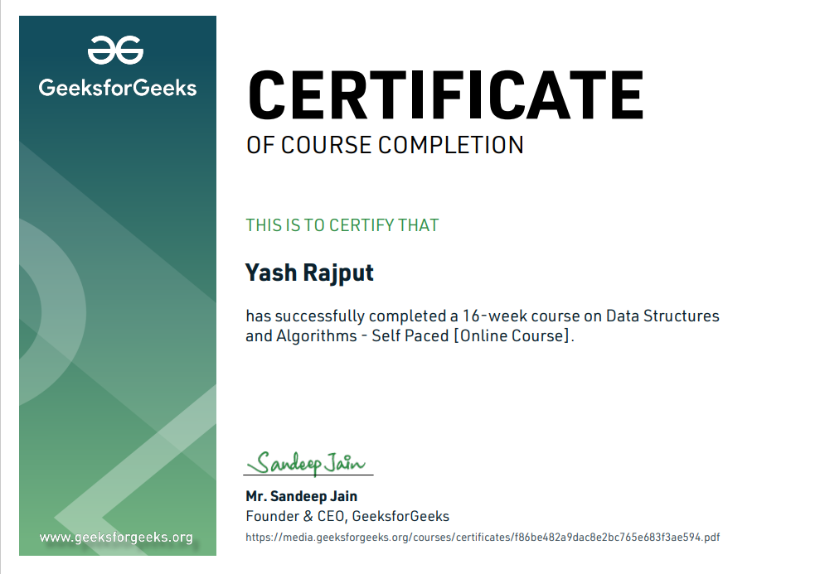
Certificate

Slide 4
Introduction
DSA self-paced course is a complete package that helped me to learn Data Structures and Algorithms from Basic to an Advance level. The course curriculum has been divided into 10 weeks, where I practiced questions and I have attempted the assessment tests accordingly.
This course does not require any prior knowledge of Data Structure and Algorithms, but a basic knowledge of any programming language ( C++ ) will be helpfulI will master all the important topics of data structures and algorithm like sorting, strings, heaps, DP, searching, trees and more and even learn this concepts by practicing on real-world projects.

Slide 5
WHAT IS ALGORITHM
Analysis of Algorithm: in this I learned about background analysis through a Program and its functions.
Order of Growth : A mathematical explanation of the growth analysis through limits and functions. A direct way of calculating the order of growth
Asymptotic Notations : Best, Average and Worst case explanation through a program.
Big O Notation : Graphical and mathematical explanation.
Omega Notation : Graphical and mathematical explanation. Calculation.

Slide 6
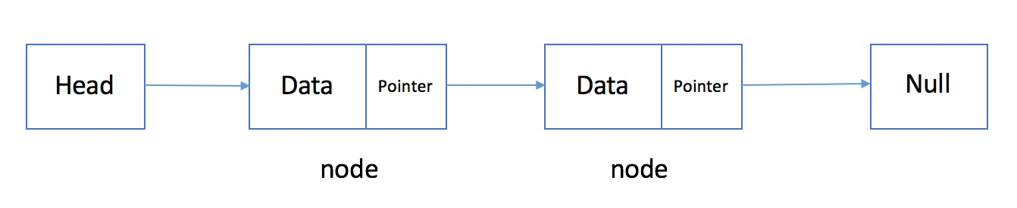
Linked list
A linked list is a linear data structure, in which the elements are not stored at contiguous memory locations.
• Doubly Linked List • Circular Linked List • Loop Problems ; Detecting loops using Floyd cycle detection ; Detecting and Removing Loops in linked lists.
pointer

Slide 7
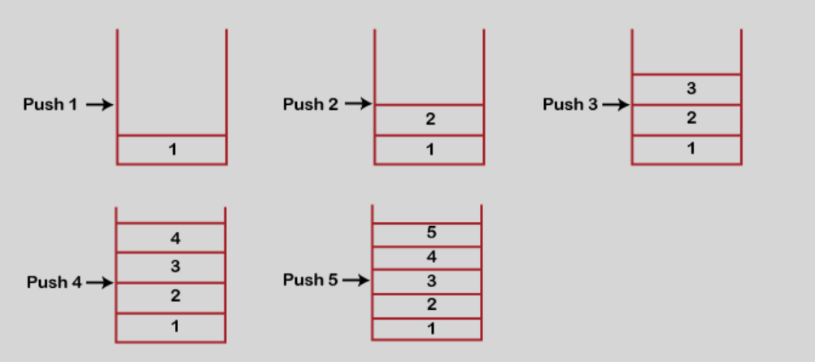
Stack Stacks are a type of container adaptors with LIFO (Last in First Out) type of working, where a new element is added at one end (top) and an element is removed from that end only. Stack uses an encapsulated object of either vector or deque (by default) or list (sequential container class) as its underlying container, providing a specific set of member functions to access its elements • Understanding the Stack data structure • Applications of Stack • Implementation of Stack in Array and Linked List.

Slide 8
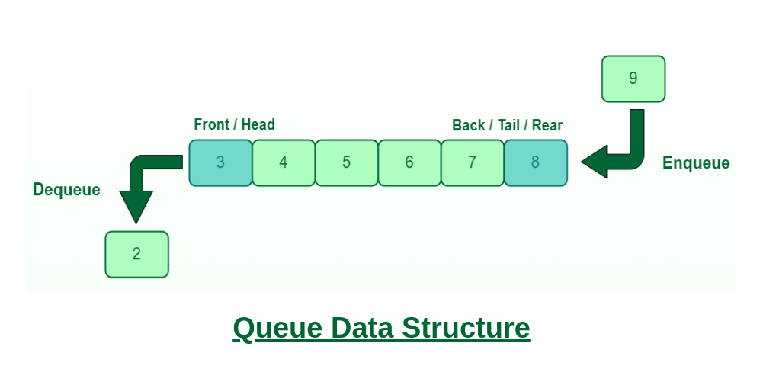
Queue
Queue is a data structure designed to operate in FIFO (First in First out) context. In queue elements are inserted from rear end and get removed from front end. Queue class is container adapter. Container is an object that hold data of same type. Queue can be created from different sequence containers.

Slide 9
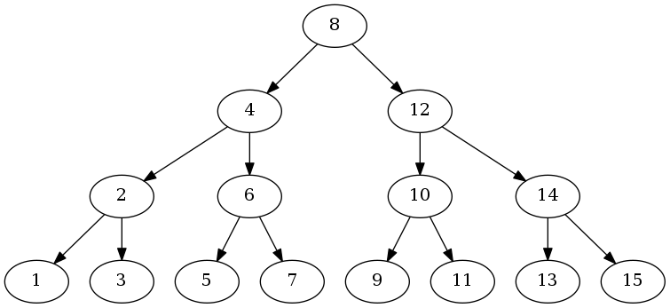
TREE
A tree is a nonlinear data structure, compared to arrays, linked lists, stacks and queues which are linear data structures. A tree can be empty with no nodes or a tree is a structure consisting of one node called the root and zero or one or more subtrees. Binary Search Tree is a tree that allows fast search, insert, delete on a sorted data. It also allows finding closest item. Heap is a tree data structure which is implemented using arrays and used to implement priority queues. B-Tree and B+ Tree They are used to implement indexing in databases.

Slide 10
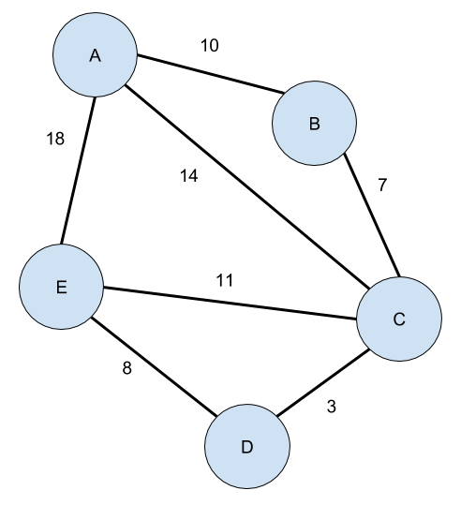
Graph
A Graph in the data structure can be termed as a data structure consisting of data that is stored among many groups of edges(paths) and vertices (nodes), which are interconnected. Graph data structure (N, E) is structured with a collection of Nodes and Edges.
Greedy is an algorithmic paradigm that builds up a solution piece by piece, always choosing the next piece that offers the most obvious and immediate benefit. So the problems where choosing locally optimal also leads to global solution are best fit for Greedy. For example, consider the Fractional Knapsack Problem Vertices: Vertices are the fundamental units of the graph. Sometimes, vertices are also known as vertex or nodes. Every node/vertex can be labeled or unlabeled.
Edges: Edges are drawn or used to connect two nodes of the graph. It can be ordered pair of nodes in a directed graph. Edges can connect any two nodes in any possible way. There are no rules. Sometimes, edges are also known as arcs.
Vertices/
nodes
edge

Slide 11

Learning outcomes
Learning outcomes for data structure and algorithms could include:
Understanding the different types of data structures and algorithms and their applications
Being able to analyze the performance of different data structures and algorithms
Being able to design and implement efficient data structures and algorithms
Being able to apply data structures and algorithms to solve real-world problems
Being able to communicate effectively about data structures and algorithms

Slide 12
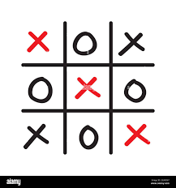
PROJECT
PROJECT
TIC-TAC-TOE
TIC-TAC-TOE
TIK-TAC-TOE
Tic-tac-toe is a game in between player and computer take turns in drawing either an ` O' or an ` X' in one square of a grid consisting of nine squares. The winner is the first player to get three of the same symbols in a row.

Slide 13
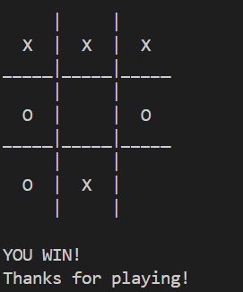
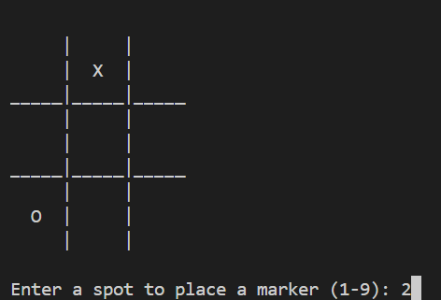
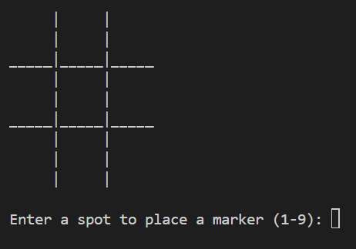
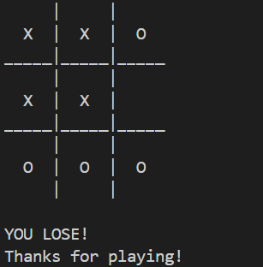
OUTPUT OF THE PROJECT

Slide 14
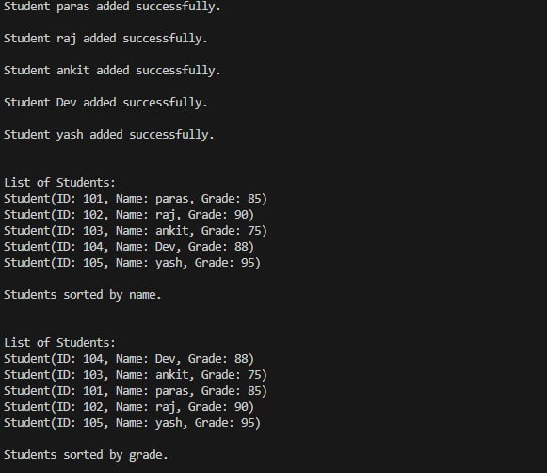
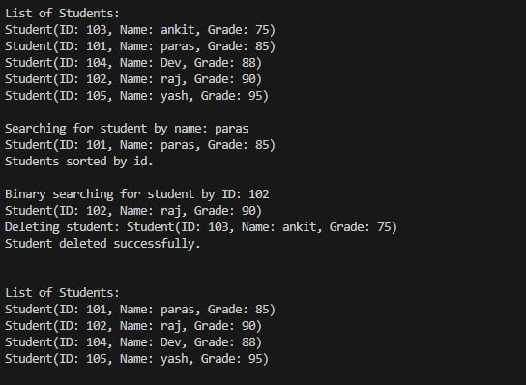
Output of Student management System project

Slide 15


Summary
data structure is a data organization, management, and storage format that enables efficient access and modification. More precisely, a data structure is a collection of data values, the relationships among them, and the functions or operations that can be applied to the data, i.e., it is algebraic expression about data. Data structures are generally based on the ability of a computer to fetch and store data at any place in its memory, specified by a pointer—a bit string, representing a memory address, that can be itself stored in memory and manipulated by the program. Thus, the array and record data structures are based on computing the addresses of data items with arithmetic operations, while the linked data structures are based on storing addresses of data items within the structure itself.

Slide 16

THANK YOU

